Slide 1
INTERFACE
OOP

Slide 2
INTERFACE? In JAVA
is defined as an abstract type used to specify the behavior of a class
contains static constants and abstract methods
A class can implement multiple interfaces
interfaces are declared using the interface keyword
All methods in the interface are implicitly public and abstract

Slide 3
INTERFACE? In JAVA
To use an interface in your class, append the keyword “implements” after your class name followed by the interface name
interface Name_of_the_Interface{
//methods
}

Slide 4
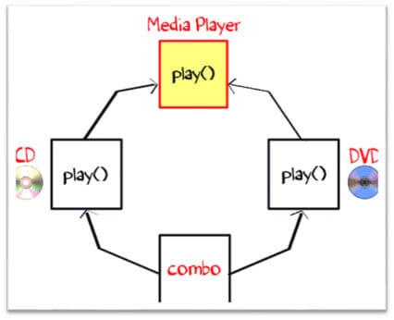
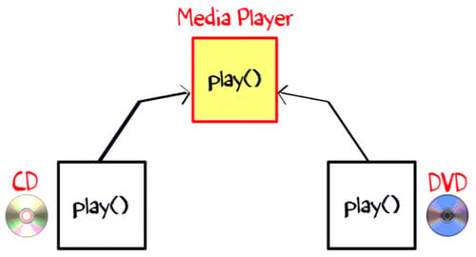
INTERFACE Why required?
class “Media Player” has two subclasses: CD player and DVD player
Each having its unique interface implementation in Java method to play music
Another class “Combo drive” is inheriting both CD and DVD
Which play method should it inherit?
This may cause serious design issues
→ Java does not allow multiple inheritance

Slide 5
INTERFACE? In JAVA
To use an interface in your class, append the keyword “implements” after your class name followed by the interface name
interface Pet{
public void test();
}
class Dog implements Pet{
public void test(){
System.out.println("Interface Method Implemented");
}
public static void main(String args[]){
Pet p = new Dog();
p.test();
}
}

Slide 6
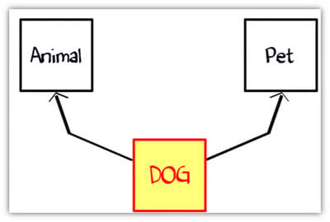
INTERFACE? In JAVA – Another Example
Suppose you have a requirement where class “dog” inheriting class “animal” and “Pet”
But you cannot extend two classes in Java
So what would you do? The solution is Interface.
A Java interface is a 100% abstract class and has only abstract methods
A “Class” can implement any number of interfaces
Class Dog can extend to class “Animal” and implement interface as “Pet”.

Slide 7
Difference between Class & Interface
CLASS | INTERFACE
instantiate variable and create an object | you can’t instantiate variable and create an object
Concrete methods | cannot contain concrete(with implementation) methods

Slide 8
When to use Abstract Class & Interface
ABSTRACT CLASS → when a template needs to be defined for a group of subclasses
INTERFACE → when a role needs to be defined for other classes, regardless of the inheritance tree of these classes

Slide 9
INTERFACE (must know)
A Java class can implement multiple Java Interfaces
The class must implement all the methods declared in the interface
All methods in an interface are implicitly public and abstract
An interface cannot be instantiated
An interface cannot implement another Interface
The class cannot implement two interfaces in java that have methods with same name but different return type.

Slide 10
ACCESS MODIFIERS
The access modifiers determine which data members (methods or fields) of a class can be accessed by other data members of classes or packages
allow us to set the scope or accessibility or visibility of a data member be it a field, constructor, class, or method.
Java also provides non-access specifiers that are used with classes, variables, methods, constructors, etc. The non-access specifiers/modifiers define the behavior of the entities to the JVM.
Static, final, abstract, …

Slide 11
TYPES of ACCESS MODIFIERS
Default: Whenever a specific access level is not specified, then it is assumed to be ‘default’. The scope of the default level is within the package.
Public: This is the most common access level and whenever the public access specifier is used with an entity, that particular entity is accessible throughout from within or outside the class, within or outside the package, etc.
Protected: The protected access level has a scope that is within the package. A protected entity is also accessible outside the package through inherited class or child class.
Private: When an entity is private, then this entity cannot be accessed outside the class. A private entity can only be accessible from within the class.

Slide 12
TYPES of ACCESS MODIFIERS
Access Modifier | Inside Class | Inside Package | Outside package subclass | Outside package
Private | Yes | No | No | No
Default | Yes | Yes | No | No
Protected | Yes | Yes | Yes | No
Public | Yes | Yes | Yes | Yes

Slide 13
default access modifier
Whenever the access modifier is not specified, then it is assumed to be the default.
The entities like classes, methods, and variables can have a default access.
A default class is accessible inside the package but it is not accessible from outside the package
Similarly a default method or variable is also accessible inside the package in which they are defined and not outside the package.

Slide 14
public access modifier
A class or a method or a data field specified as ‘public’ is accessible from any class or package in the Java program
The public entity is accessible within the package as well as outside the package
public access modifier is a modifier that does not restrict the entity at all

Slide 15
Protected Access Specifier
allows access to entities through subclasses of the class in which the entity is declared
It doesn’t matter whether the class is in the same package or different package
a class and an interface cannot be protected!
we cannot apply protected modifiers to classes and interfaces
The protected access modifier is usually used in parent-child relationships

Slide 16
Private Access Modifier
the one that has the lowest accessibility level.
The methods and fields that are declared as private are not accessible outside the class
They are accessible only within the class which has these private entities as its members
the private entities are not even visible to the subclasses of the class
A private access modifier ensures encapsulation in Java

Slide 17
Private Access Modifier
Private access modifier cannot be used for classes and interfaces.
The scope of private entities (methods and variables) is limited to the class in which they are declared

Slide 18
NON-ACCESS MODIFIERS
Java provides a number of non-access modifiers to achieve many other functionalities.
The static modifier for creating class methods and variables.
The final modifier for finalizing the implementations of classes, methods, and variables.
The abstract modifier for creating abstract classes and methods.

Slide 19
STATIC MODIFIER
Static Variables
The static keyword is used to create variables that will exist independently of any instances created for the class.
Only one copy of the static variable exists regardless of the number of instances of the class.
Static variables are also known as class variables. Local variables cannot be declared static.

Slide 20
STATIC MODIFIER
Static Methods
The static keyword is used to create methods that will exist independently of any instances created for the class.
Static methods do not use any instance variables of any object of the class they are defined in. Static methods take all the data from parameters and compute something from those parameters, with no reference to variables.
Class variables and methods can be accessed using the class name followed by a dot and the name of the variable or method.

Slide 21
FINAL MODIFIER
Final Variables
A final variable can be explicitly initialized only once. A reference variable declared final can never be reassigned to refer to an different object.
With variables, the final modifier often is used with static to make the constant a class variable.

Slide 22
FINAL MODIFIER
Final Methods
A final method cannot be overridden by any subclasses.
The final modifier prevents a method from being modified in a subclass.
The main intention of making a method final would be that the content of the method should not be changed by any outsider.

Slide 23
FINAL MODIFIER
Final Classes
The main purpose of using a class being declared as final is to prevent the class from being subclassed. If a class is marked as final then no class can inherit any feature from the final class.

